Slide 1
AJAX
Udayraj Bal

Slide 2
Web Technologies
Client Side:
  HTML/XML
  JavaScript
    Plain-text Code
    Supported by most web clients on all platforms
    Object Oriented capabilities
    Insecure – gets downloaded in the web client
    Interpreted – not good for complex calculations
  Java Applets
    Popular, powerful Java language
    Complex calculations
    Needs JVM installed in the web client separately
    Long startup times
    Consumes lot of system resources
    Too heavy & powerful for small requirements of web applications
  Macromedia Flash
    Powerful for animations and graphical effects
    Requires a separate flash plugin installed in the web client
CONFIDENTIAL© Copyright 2007 Tech Mahindra Limited

Slide 3


What is missing?
Web applications without Flash, Java Applets
Typical website access scenario:
Execute ASP .NET page
Create HTML + JavaScript
Send it to Web Client
http://techmahindra.com/index.aspx
Client Browser
HTML + JavaScript content
Web Server
CONFIDENTIAL© Copyright 2007 Tech Mahindra Limited

Slide 4
AJAX: Definition
Ajax isn’t a technology
  Ajax combines several technologies together to create powerful applications
Ajax incorporates:
  Standards-based presentation using XHTML and CSS;
  Dynamic display and interaction using the Document Object Model;
  Data interchange and manipulation using XML and XSLT;
  Asynchronous data retrieval using XMLHttpRequest;
  and JavaScript binding everything together.
CONFIDENTIAL© Copyright 2007 Tech Mahindra Limited

Slide 5
A typical AJAX Call:
Client requests a ASP .NET page
Execute ASP .NET page
Create HTML + JavaScript
Send it to Web Client
Response containing HTML + JS
JavaScript code makes
invisible call to server
Client
Browser
Server replies by sending
the requested data
Web Server
JavaScript updates the
web page using this data
CONFIDENTIAL© Copyright 2007 Tech Mahindra Limited

Slide 6
Ajax Basics
CONFIDENTIAL© Copyright 2007 Tech Mahindra Limited

Slide 7
What AJAX is made up of?
JavaScript
  Client side scripting
  Makes heavy use of Document Object Model (DOM)
XMLHttpRequest Object
  Enables JavaScript to make asynchronous HTTP requests
A Server - Side technology
  Required to handle the JavaScript requests
A Data Interchange form
  XML & XSLT
  JSON (JavaScript Object Notation)
CONFIDENTIAL© Copyright 2007 Tech Mahindra Limited

Slide 8
JavaScript
Interpreted
  Runs in the browser on the client side
Object-Oriented
  Fully object – oriented, good support for DOM
Available
  All the modern browsers have JavaScript engines
Familiar
  Borrows syntax and conventions from popular programming languages like C/C++, Java
Non – standard
  Created by NetScape and implemented by all other browser vendors
  W3C tries standardization
Confusing
  Due to implementation differences
Frustrating
  Due browser bugs, memory leaks and other irrational behaviour
CONFIDENTIAL© Copyright 2007 Tech Mahindra Limited

Slide 9
A HTTP Primer
CONFIDENTIAL© Copyright 2007 Tech Mahindra Limited

Slide 10
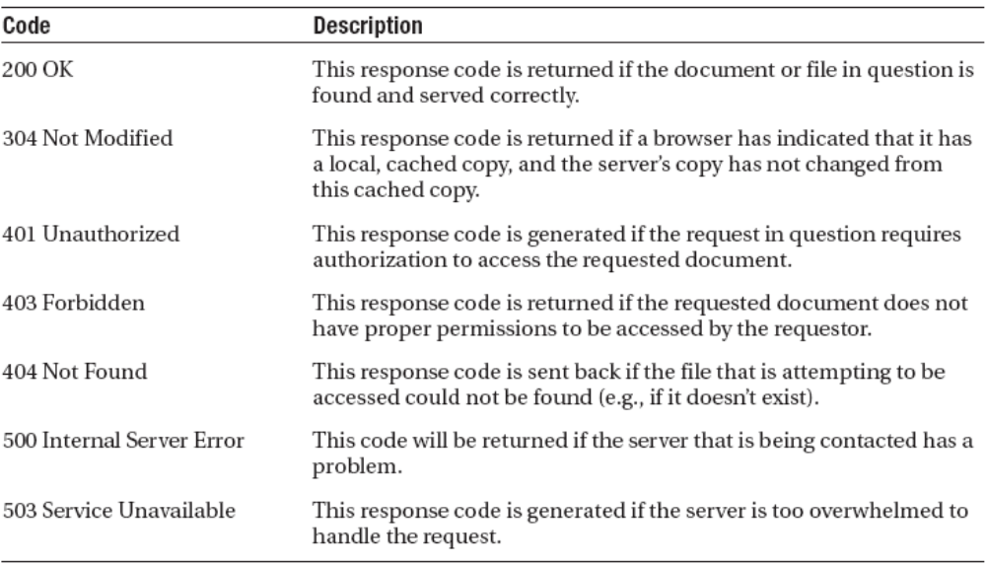
HTTP Request and Response Fundamentals
Common HTTP Response codes
CONFIDENTIAL© Copyright 2007 Tech Mahindra Limited

Slide 11
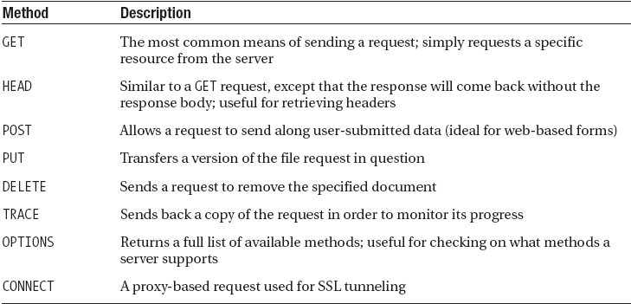
HTTP Request Methods
CONFIDENTIAL© Copyright 2007 Tech Mahindra Limited

Slide 12
The XMLHttpRequest Object - XHR
CONFIDENTIAL© Copyright 2007 Tech Mahindra Limited

Slide 13
XMLHttpRequest Object
Originally created by Microsoft as an ActiveX component for their outlook web – client, shipped with IE 5.5.
Implemented by Mozilla, and others
Supports asynchronous client – side request
CONFIDENTIAL© Copyright 2007 Tech Mahindra Limited

Slide 14
XMLHttpRequest Methods
Method | Description
abort() | Cancels the current request
getAllResponseHeaders() | Returns all HTTP headers as a String type variable
getResponseHeader() | Returns the value of the HTTP header specified in the method
open() | Specifies the different attributes necessary to make a connection to the server; allows you to make selections such as GET or POST (more on that later), whether to connect asynchronously, and which URL to connect to
setRequestHeader() | Adds a label/value pair to the header when sent
send() | Sends the current request
CONFIDENTIAL© Copyright 2007 Tech Mahindra Limited
Notes:
Example Header
Date: Sun, 13 Nov 2005 22:53:06 GMT
Server: Apache/2.0.53 (Win32) PHP/5.0.3
X-Powered-By: PHP/5.0.3
Content-Length: 527
Keep-Alive: timeout=15, max=98
Connection: Keep-Alive
Content-Type: text/html

Slide 15
XMLHttpRequest Properties
Property | Description
onreadystatechange | Used as an event handler for events that trigger upon state changes
readyState | Contains the current state of the object (0: uninitialized, 1: loading, 2: loaded, 3: interactive, 4: complete)
responseText | Returns the response in string format
responseXML | Returns the response in proper XML format
status | Returns the status of the request in numerical format (regular page errors are returned, such as the number 404, which refers to a not found error)
statusText | Returns the status of the request, but in string format (e.g., a 404 error would return the string Not Found)
CONFIDENTIAL© Copyright 2007 Tech Mahindra Limited

Slide 16
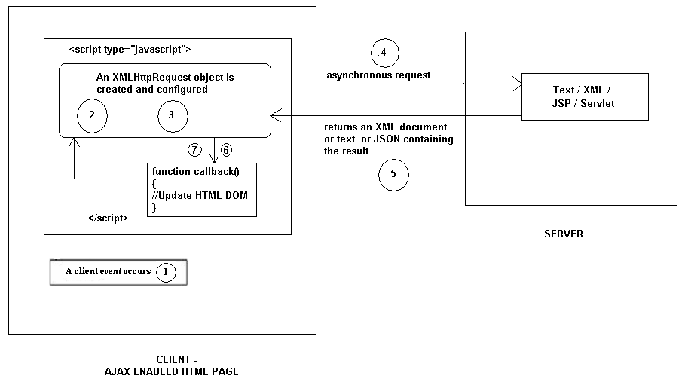
AJAX steps
CONFIDENTIAL© Copyright 2008 Tech Mahindra Limited
Notes:
The step 1 is where the client event occurs. It may be a click of a submit button or select from a drop down box or a document loading in the browser. As soon as the client event occurs the XMLHttpRequest object is created and configured. This is indicated by step 2 and 3 on the slide. The XMLHttpRequest object then sends HTTP request along with what the user has typed in to the server. That is number 4 on the slide. The server then does the processing and sends the data requested by the client. The data may be in plain text or xml or JSON format . This is denoted as number 5 in the slide. The callback function on the client side is then called. The callback function then changes a HTML element in the page to reflect the data that has been received from the server. This is denoted by steps 6 and 7 on the slide.

Slide 17
First step: create an instance
Create Object
  Take Care of Browser Specific Creation !
Example
  var xhr = new XMLHttpRequest(); // Firefox, Opera 8.0+, Safari
  var xhr = new ActiveXObject("Microsoft.XMLHTTP"); // Internet Explorer 5.5+
  var xhr = new ActiveXObject("Msxml2.XMLHTTP "); // Internet Explorer 6+
Firefox,opera 8.0, Safari uses the built-in JavaScript object called XMLHttpRequest.
Internet Explorer uses an ActiveXObject
CONFIDENTIAL© Copyright 2008 Tech Mahindra Limited
Notes:
As soon as the client event occurs the first step is to create an instance of the XMLHttpRequest object. The keystone of AJAX is the XMLHttpRequest object. Different browsers use different methods to create the XMLHttpRequest object.
Internet Explorer uses an ActiveXObject, while other browsers uses the built-in JavaScript object called XMLHttpRequest.

Slide 18
Second step: wait for the response
Set up a function to handle the event when the readyState is changed to 4
  0 – The request is not initialized
  1 – The request has been set up
  2 – The request has been sent
  3 – The request is in process
  4 – The request is complete
Example
xhr.onreadystatechange = function() {
if(xhr.readyState==4) {
// Request is Complete
if (xhr.status == 200) {
// The response was HTTP OK so everything went on well
// Process the response
}
else {
// Wait...
}
}
Call back function gets called asynchronously whenever state change occurred on the XMLHttpRequest object.
CONFIDENTIAL© Copyright 2008 Tech Mahindra Limited
Notes:
Once XMLHttpRequest object is created, the next thing to do is to set the “onreadystatechange” property of the XMLHttpRequest object to a callback function. This callback function gets called asynchronously whenever state change occurred on the XMLHttpRequest. In this code snippet, the name of the callback function is “function”.

Slide 19
Third step: make the request itself
Two methods of XMLHttpRequest are used:
  Open() to initialize connection to Server
  Send() to send the actual Data
Example
  xhr.open("GET","time.jsp",true);
  xhr.send("name=Bob&email=bob@example.com");
CONFIDENTIAL© Copyright 2008 Tech Mahindra Limited
Notes:
Then the “open” method of the XMLHttpRequest gets called. The “open” method requires three parameters: the HTTP method, which is GET or POST; the URL of the server-side component that the object will interact with; and a boolean indicating whether or not the call will be made asynchronously. In this example, and in most cases, it is set to “true”, which means the HTTP request/response interaction occurs in asynchronous fashion.

Slide 20
Processing the Response
The content of the response can be accessed via two properties of XMLHttpRequest object:
  responseXML
    This property contains an XML document object. If the response is not XML, this property will be empty.
  responseText
    This property contains the response from the server as a normal string.
Example:
  var nameNode = xhr.responseXML.getElementsByTagName("name")[0];
  Var text = xhr.responseText;
CONFIDENTIAL© Copyright 2008 Tech Mahindra Limited
Notes:
Text/plain or text/html.

Slide 21
So I must know JavaScript?
No!
You can still get AJAX in your application
Ajax and JavaScript Frameworks
  DOJO
  Prototype
  ExtJS
  AJAX .NET
  And may more …
CONFIDENTIAL© Copyright 2007 Tech Mahindra Limited

